Slide 1

Data Analysis Project
Team
B
Mohamed Mohsen
Abdelrahman Omar
Abdelrahman Rabie
Alyaa Hassan
Menna Hassan

Slide 2

Points:
Data Cleaning
Data visualizations
Methods and roles

Slide 3
Data Cleaning

Slide 4
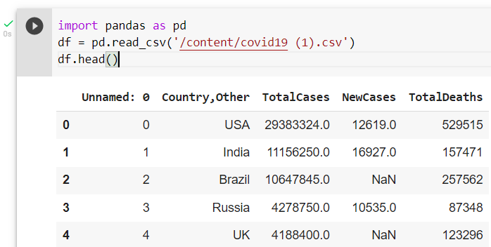
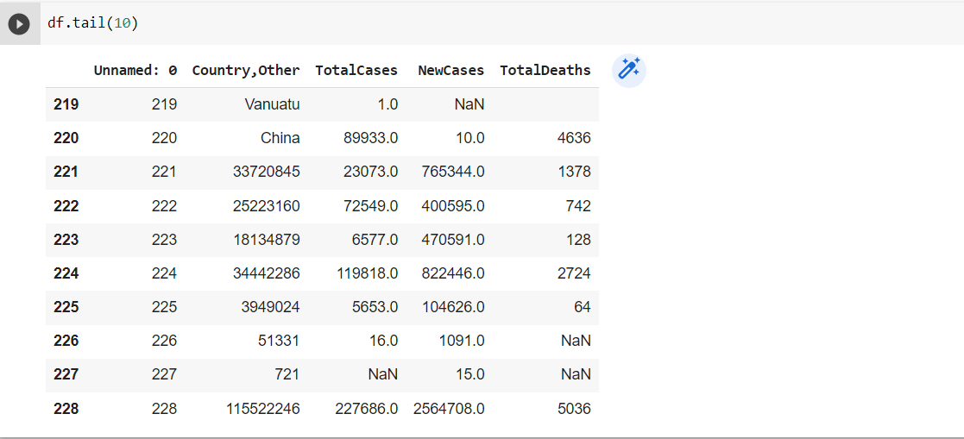

Slide 5
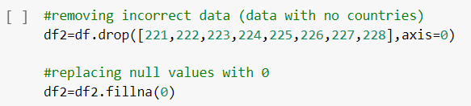
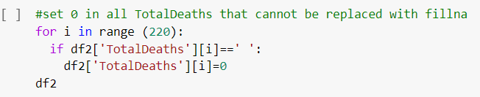

Slide 6
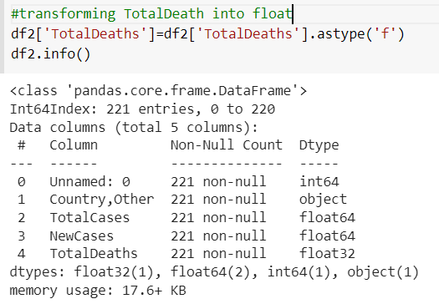


Slide 7
Data visualization

Slide 8
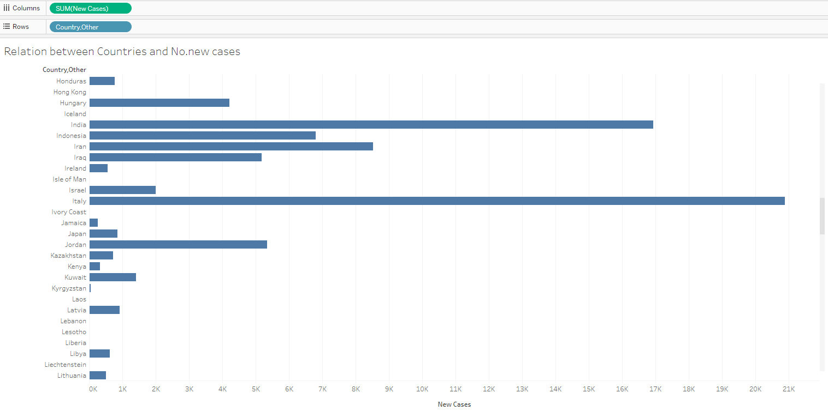

Slide 9
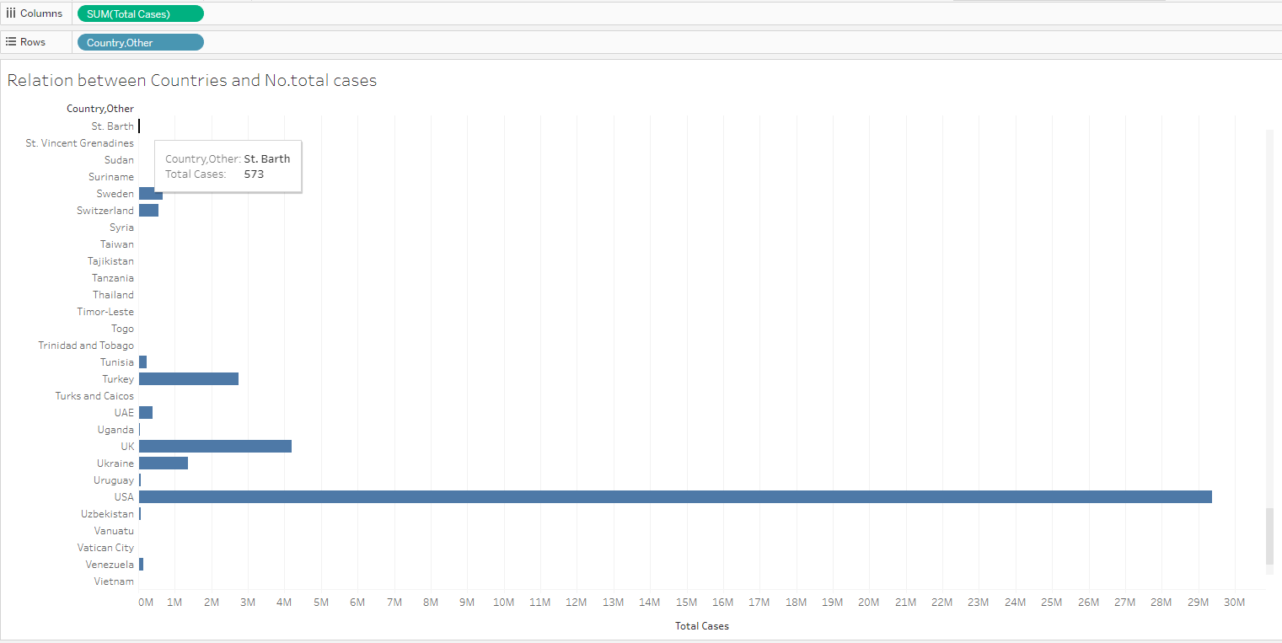

Slide 10
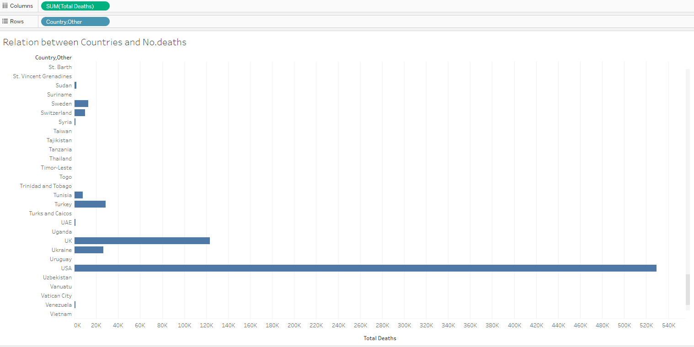

Slide 11
Heat map
to locate where most cases lie

Slide 12
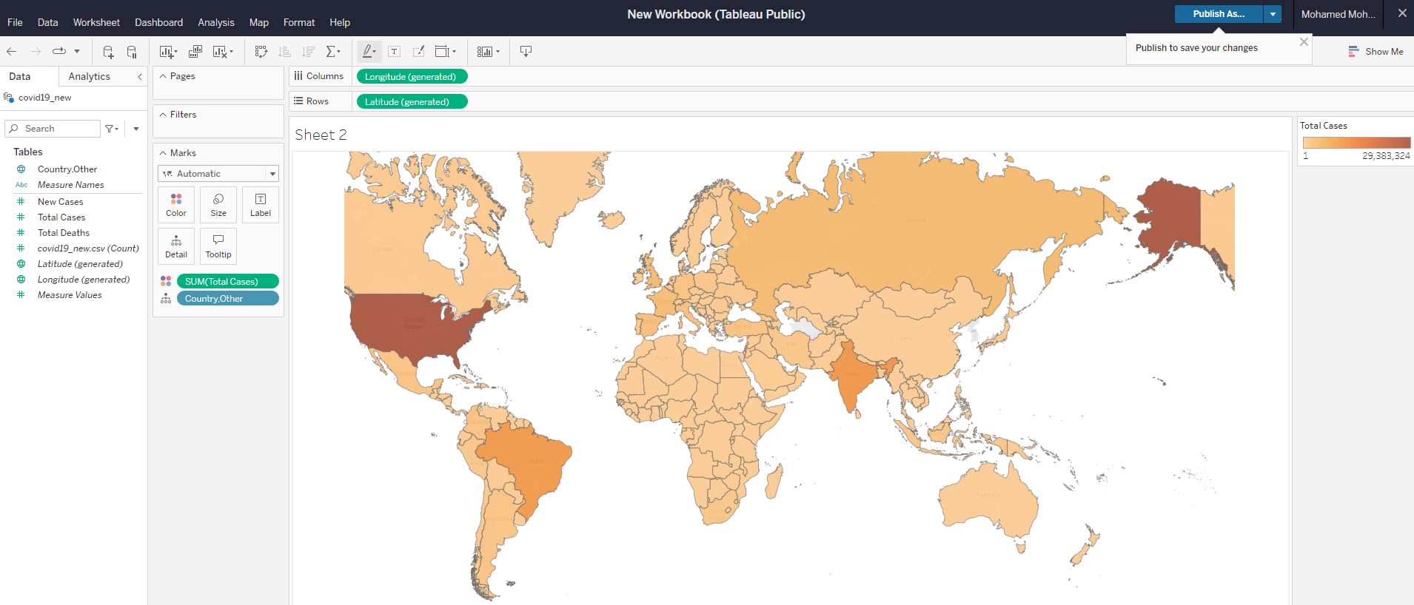

Slide 13
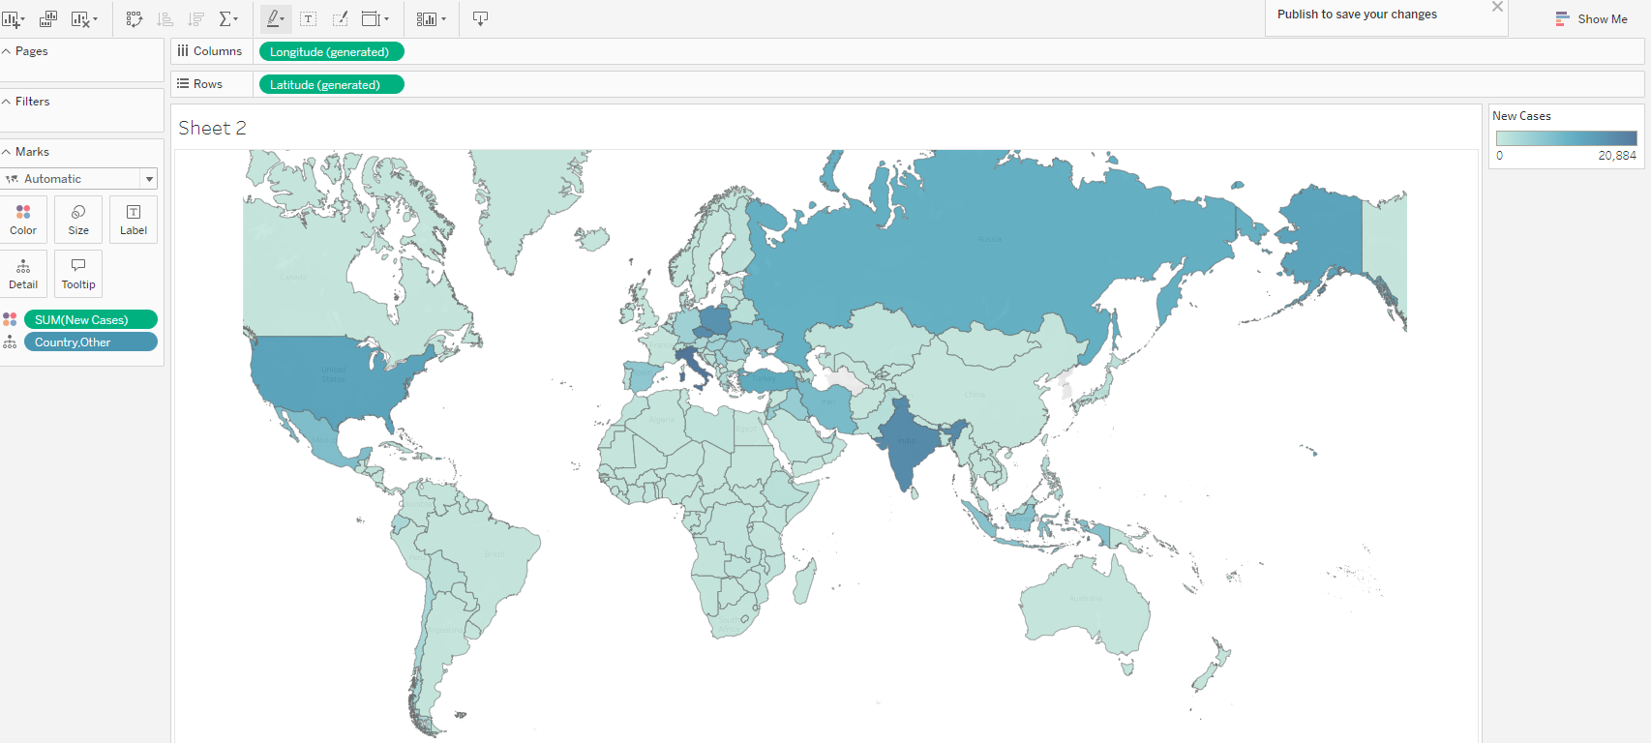

Slide 14
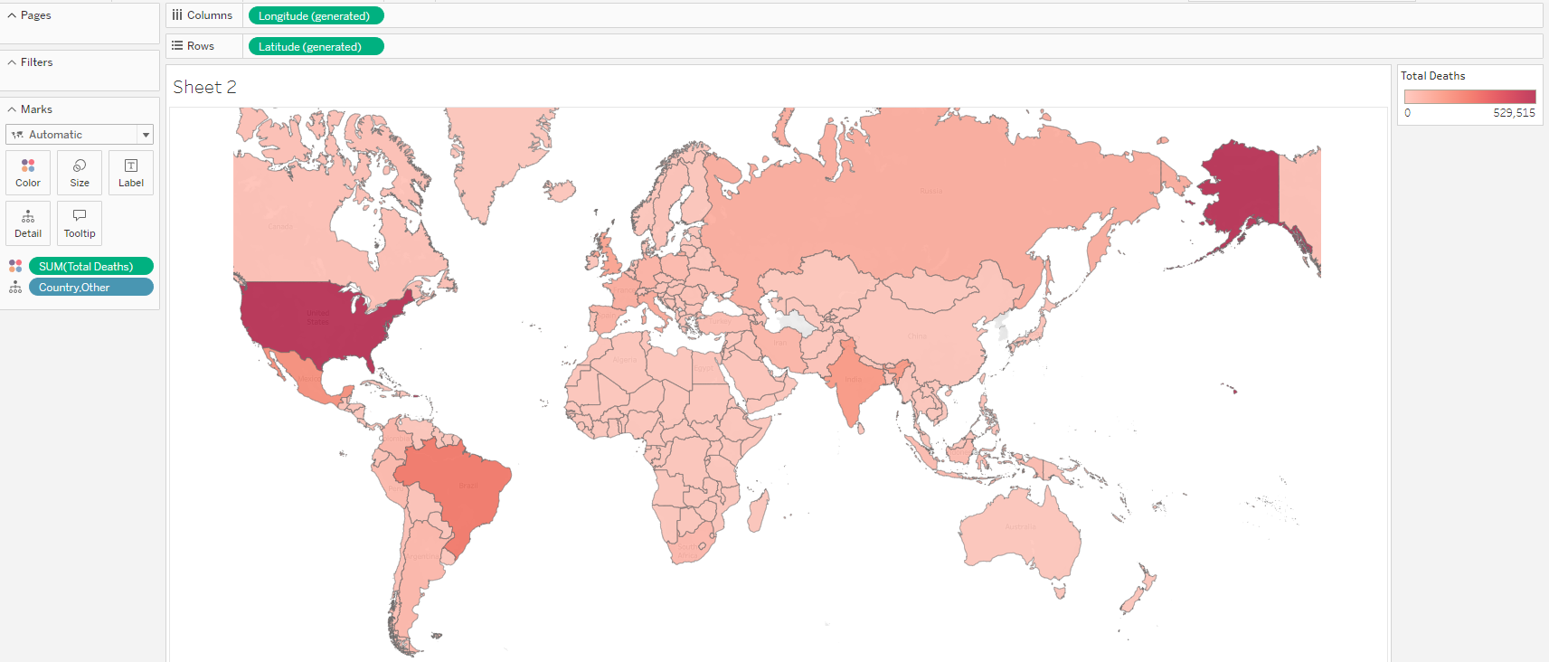

Slide 15
Finally , a scatter plotting for the cases with respect to no. deaths

Slide 16
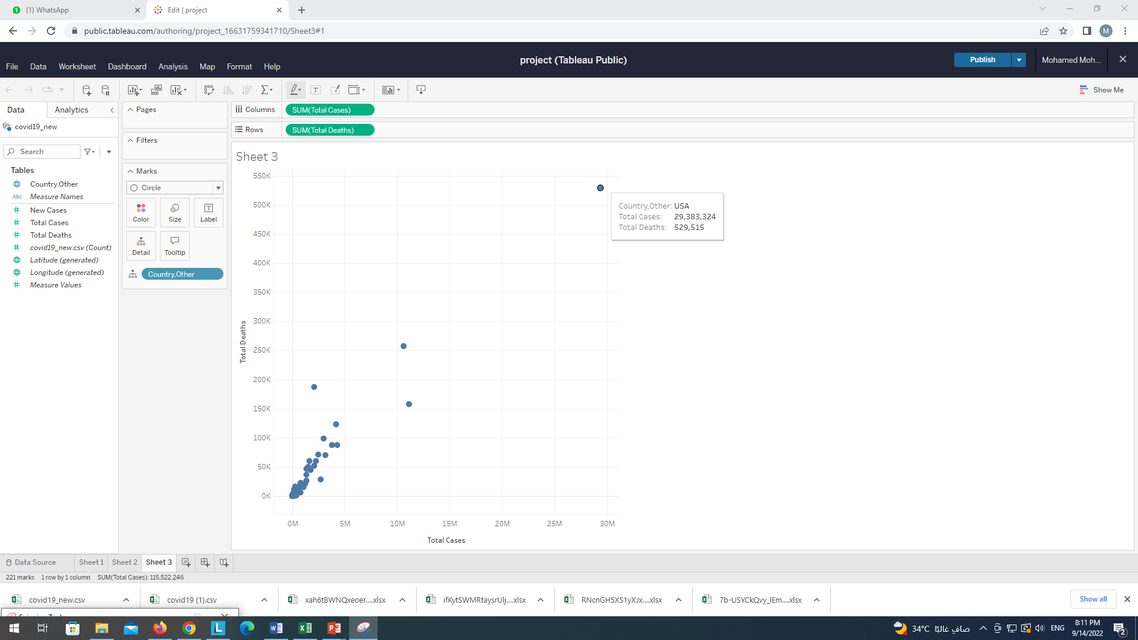

Slide 17
Methods and Roles

Slide 18
Methods: 1- spreadsheets (Excel) 2- google Colab (to run python codes to clean the data) 3- Tableau tool (for visualizations)
Roles:
cleaning process:
1- Abdelrahman Rabie
2- abdelrahman omar
Vizualizations using Tableau 1-Mohamed Mohsen
2- Menna Hassan
Presentation and research (for suitable tools and functions)
Alyaa Hassan

